Slide 1
Chapter 2: Introduction to Relational Model
Notes:
1

Slide 2
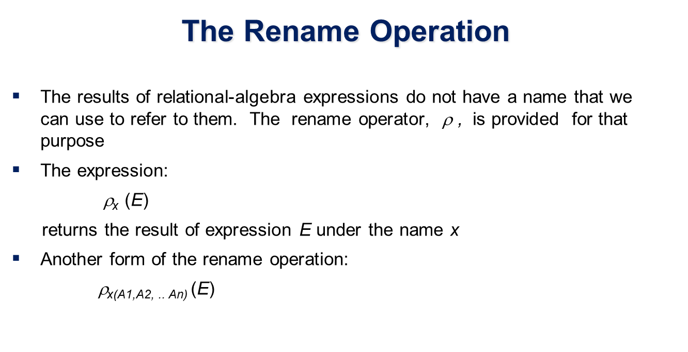

Slide 3
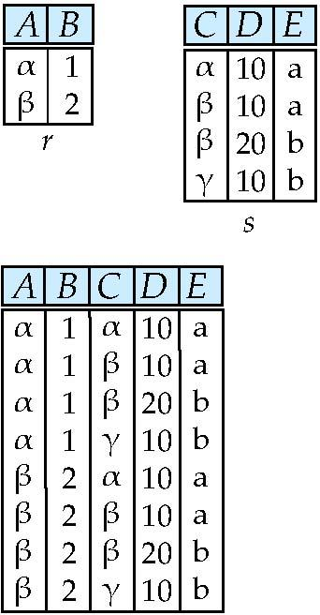
Renaming a Table
Allows us to refer to a relation, (say E) by more than one name.
ρ _{x} (E)
returns the expression E under the name X
Relations r
r.A r.B s.A s.B
r x ρ _{s} (r)
α
α
β
β
1
1
2
2
α
β
α
β
1
2
1
2
Notes:
3

Slide 4
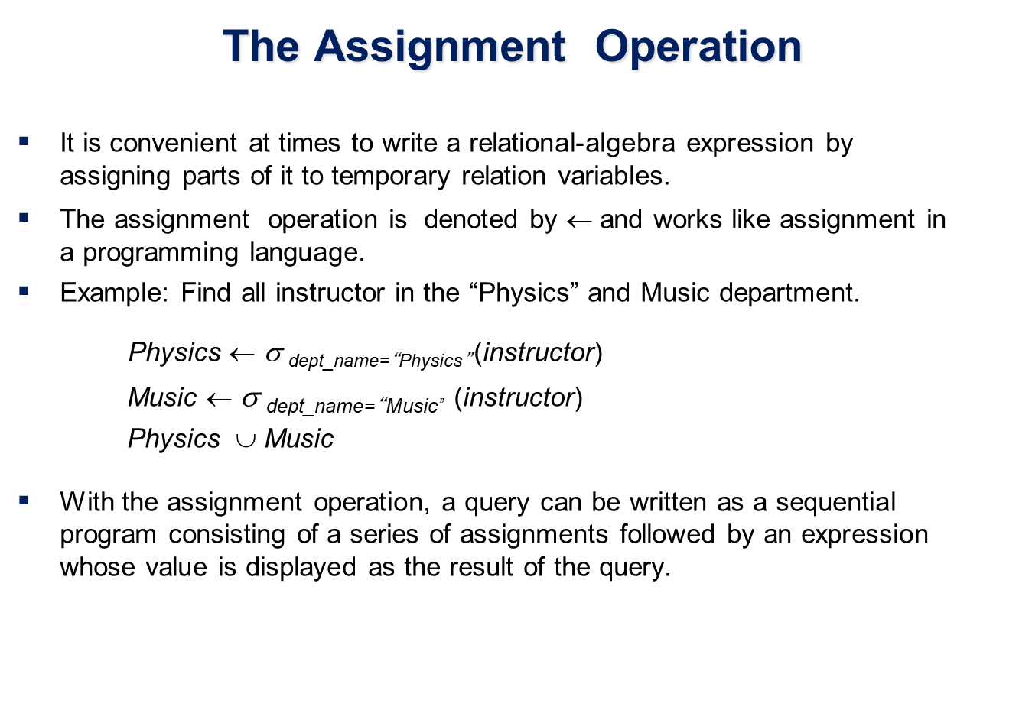

Slide 5
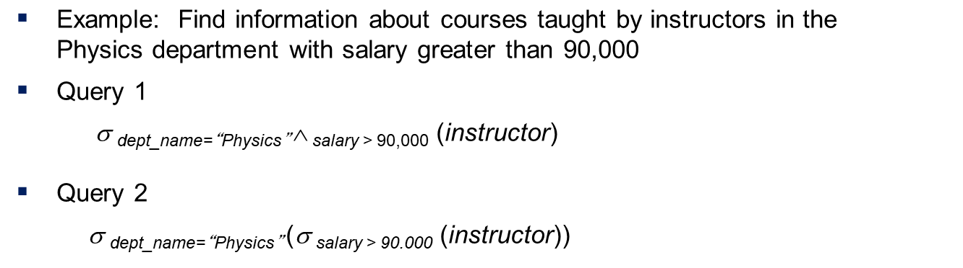

Slide 6
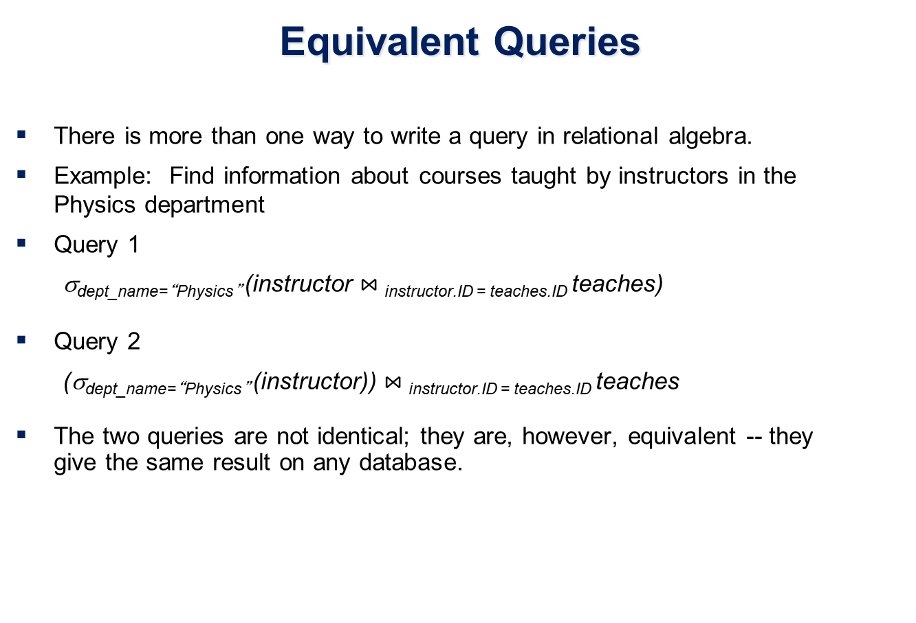

Slide 7
Banking Example
branch (branch_name, branch_city, assets)
customer (customer_name, customer_street, customer_city)
account (account_number, branch_name, balance)
loan (loan_number, branch_name, amount)
depositor (customer_name, account_number)
borrower (customer_name, loan_number)

Slide 8
Example Queries
Find all loans of over $1200
Find the loan number for each loan of an amount greater than $1200

Slide 9
Example Queries
Find the names of all customers who have a loan, an account, or both, from the bank
Find the names of all customers who have a loan and an account at bank.

Slide 10
Example Queries
Find the names of all customers who have a loan at the Perryridge branch.
Find the names of all customers who have a loan at the Perryridge branch but do not have an account at any branch of the bank.

Slide 11
Example Queries
Find the largest account balance
Strategy:
Find those balances that are not the largest
Rename account relation as d so that we can compare each account balance with all others
Use set difference to find those account balances that were not found in the earlier step.
The query is:

Slide 12
Extended Relational-Algebra-Operations
Generalized Projection
Aggregate Functions

Slide 13
Generalized Projection
Extends the projection operation by allowing arithmetic functions to be used in the projection list.
E is any relational-algebra expression
Each of F₁, F₂, …, F_{n} are are arithmetic expressions involving constants and attributes in the schema of E.
Given relation instructor(ID, name, dept_name, salary) where salary is annual salary, get the same information but with monthly salary
∏_{ID, name, dept_name, salary/12} (instructor)

Slide 14
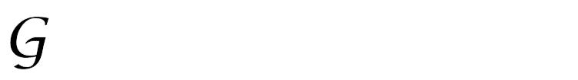
Aggregate Functions and Operations
Aggregation function takes a collection of values and returns a single value as a result.
avg: average value min: minimum value max: maximum value sum: sum of values count: number of values
Aggregate operation in relational algebra
E is any relational-algebra expression
G₁, G₂ …, G_{n} is a list of attributes on which to group (can be empty)
Each F_{i} is an aggregate function
Each A_{i} is an attribute name
Note: Some books/articles use γ instead of (Calligraphic G)

Slide 15
Aggregate Operation – Example
Relation r:
A
B
C
α
α
β
β
α
β
β
β
7
7
3
10
_{sum(c)} (r)
sum(c )
27

Slide 16
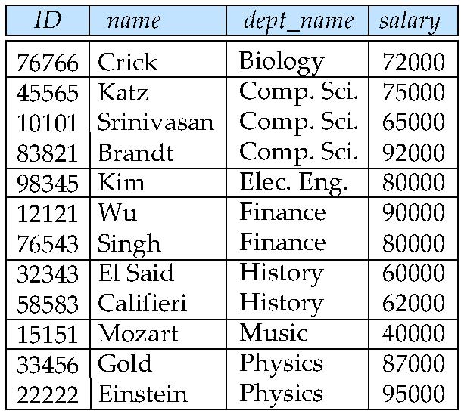
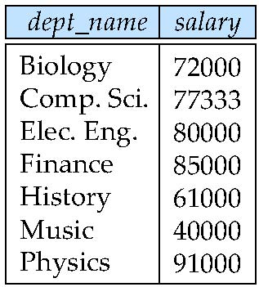
Aggregate Operation – Example
Find the average salary in each department
_{dept_name} _{avg(salary)} (instructor)
avg_salary

Slide 17
Aggregate Functions (Cont.)
Result of aggregation does not have a name
Can use rename operation to give it a name
For convenience, we permit renaming as part of aggregate operation
_{dept_name} _{avg(salary) as avg_sal} (instructor)

Slide 18
Summary of Relational Algebra Operators
Symbol (Name) Example of Use
σ
(Selection) ^{σ} salary > = 85000 ^{(instructor)}
Return rows of the input relation that satisfy the predicate.
Π
(Projection) ^{Π} ID, salary ^{(instructor)}
Output specified attributes from all rows of the input relation. Remove duplicate tuples from the output.
x
(Cartesian Product) instructor x department
Output pairs of rows from the two input relations that have the same value on all attributes that have the same name.
∪
(Union) ^{Π} name ^{(instructor) ∪ Π} name ^{(student)}
Output the union of tuples from the two input relations.
-
(Set Difference) ^{Π} name ^{(instructor)} ^{-- Π} name ^{(student)}
Output the set difference of tuples from the two input relations.
⋈
(Natural Join) instructor ⋈ department
Output pairs of rows from the two input relations that have the same value on all attributes that have the same name.
Notes:
18

Slide 19
End of Chapter 2
Notes:
19

